Slide 1
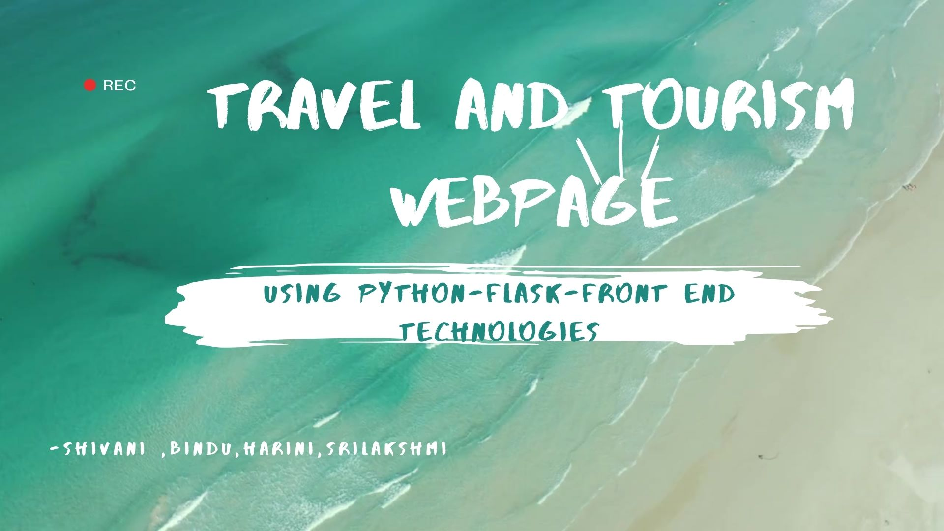
DEPARTMENT OF ELECTRONICS AND
COMMUNICATION ENGINEERING

Slide 2

03
ABSTRACT
1. Make Travel joyful
2. Lesser tension More
work
3. Automate the work of
searching places and
packages for trip
4 .Customization

Slide 3
PROBLEM STATEMENT
04
Lack of feasible
Modes of
payment
Struggle of
proper
Information
Third party Api, Working in
Tandem
According to ABTA's 'Holiday Habits' report, four out of every five people booked a vacation online in 2018, with the majority preferring a PC over mobile or tablet devices.

Slide 4
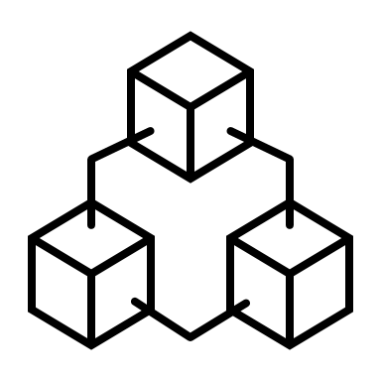



PROPOSED SOLUTION
05
For every booking, user can easily print the receipt and save them locally
Quickly navigating to different pages of the webpage is available
Easy to use UI
Can explore different packages easily.
Specially deisgned to reduce the tension of searching for a fully packed information
Separate pages for user login & sign up
.

Slide 5
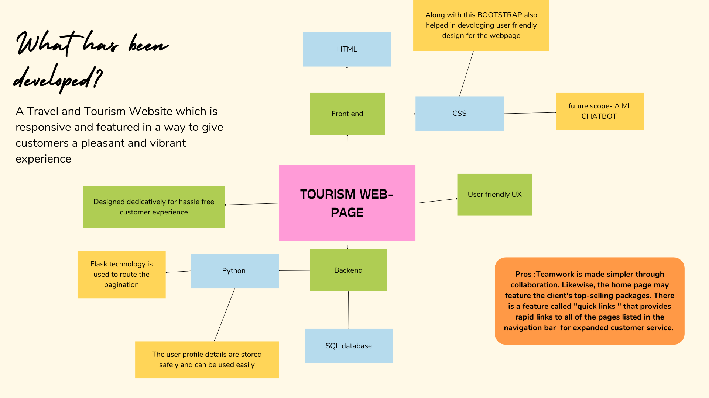
SYSTEM ARCHITECHTURE

Slide 6
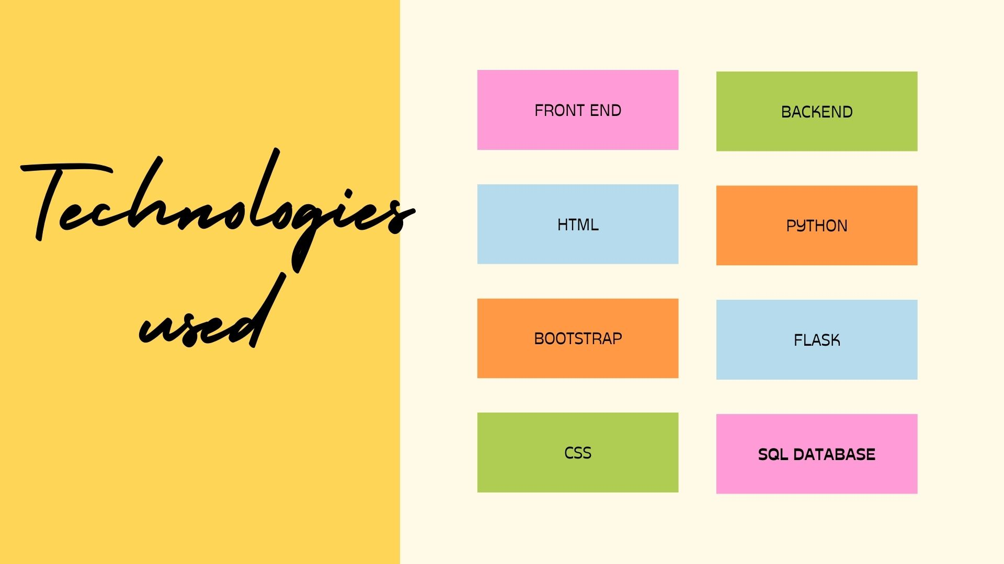

Slide 7
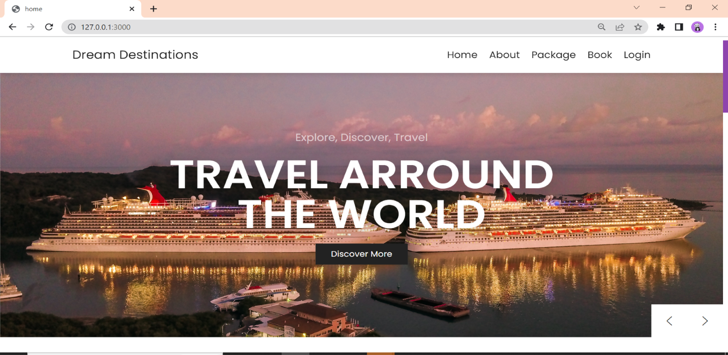
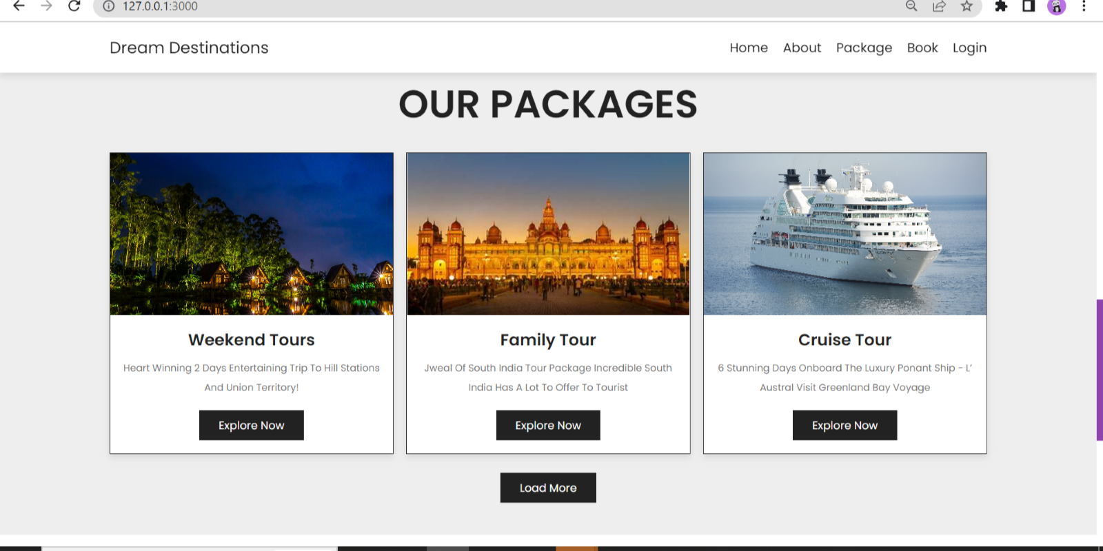
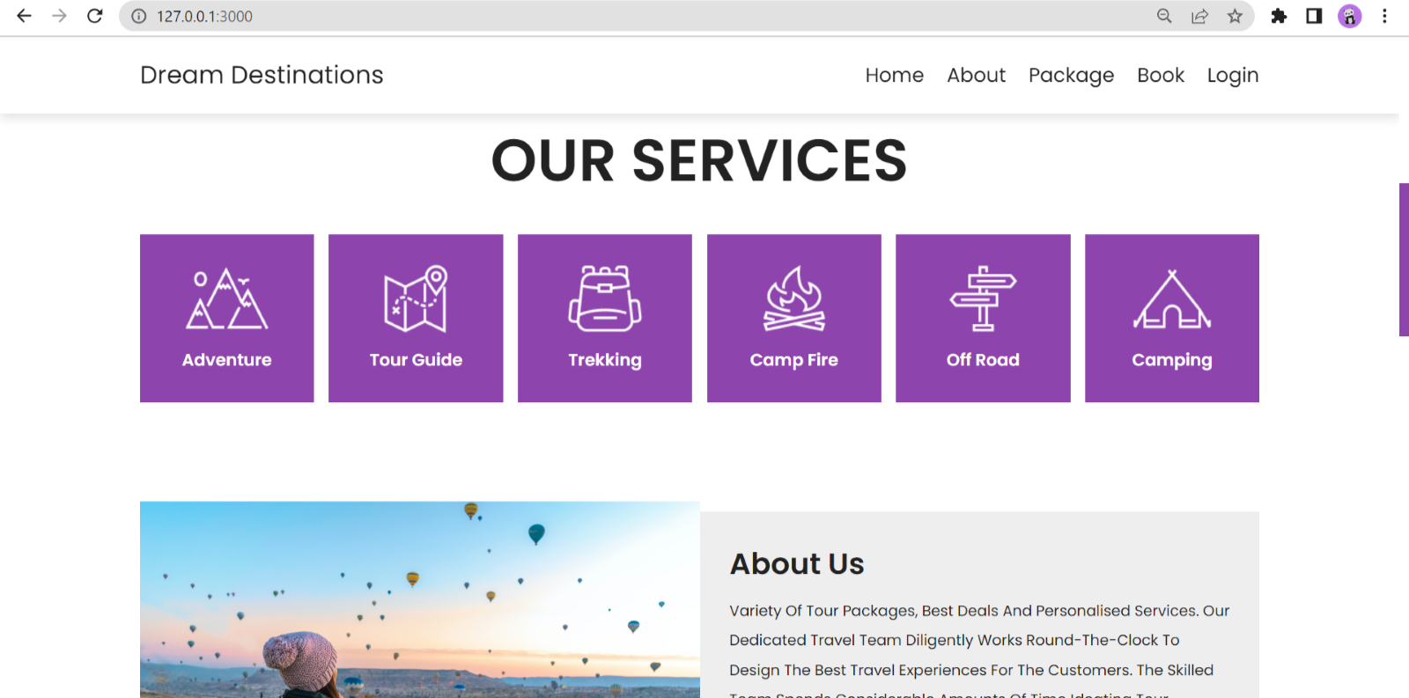
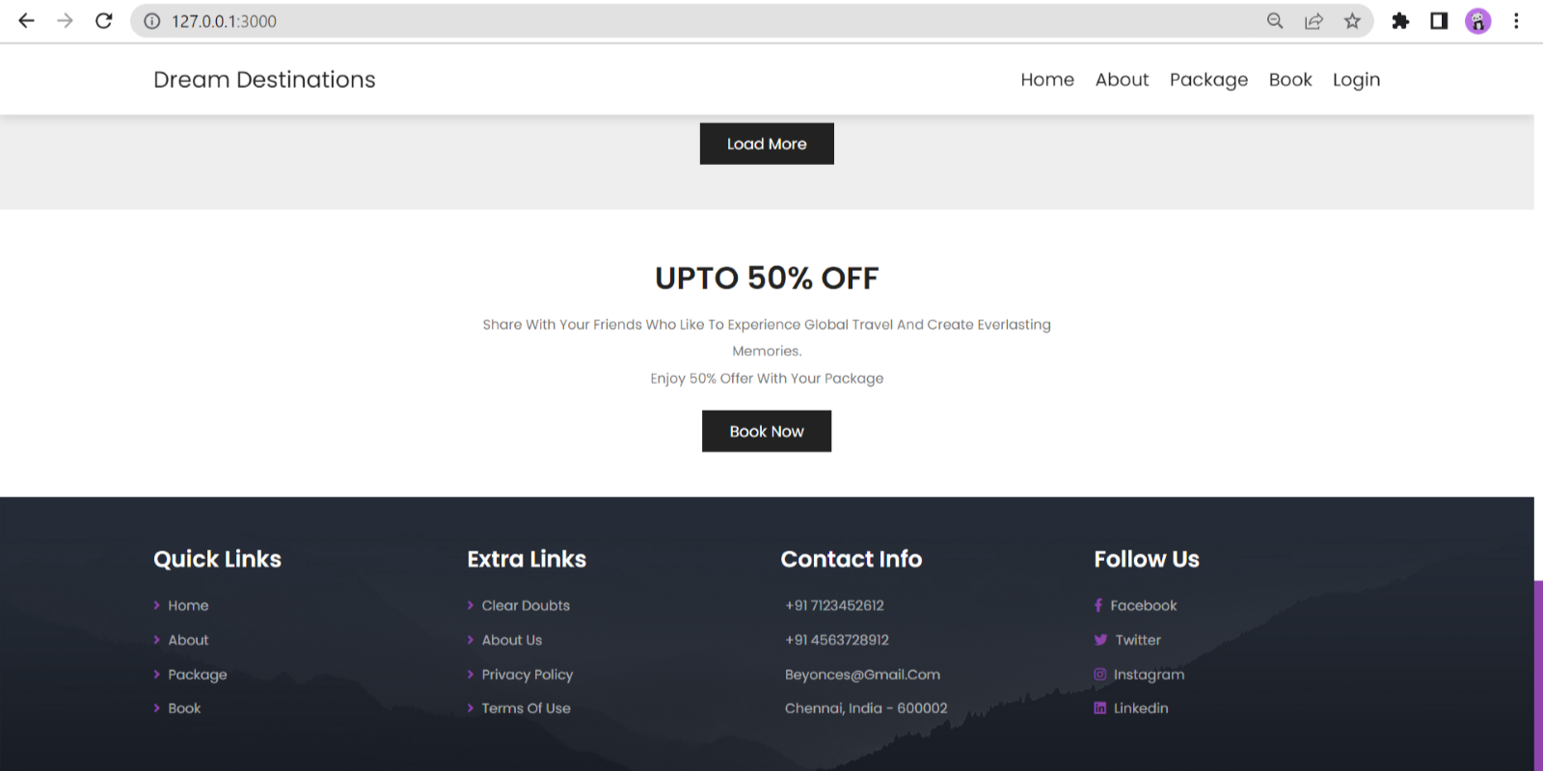
OUTPUT SCREENSHOTS

Slide 8
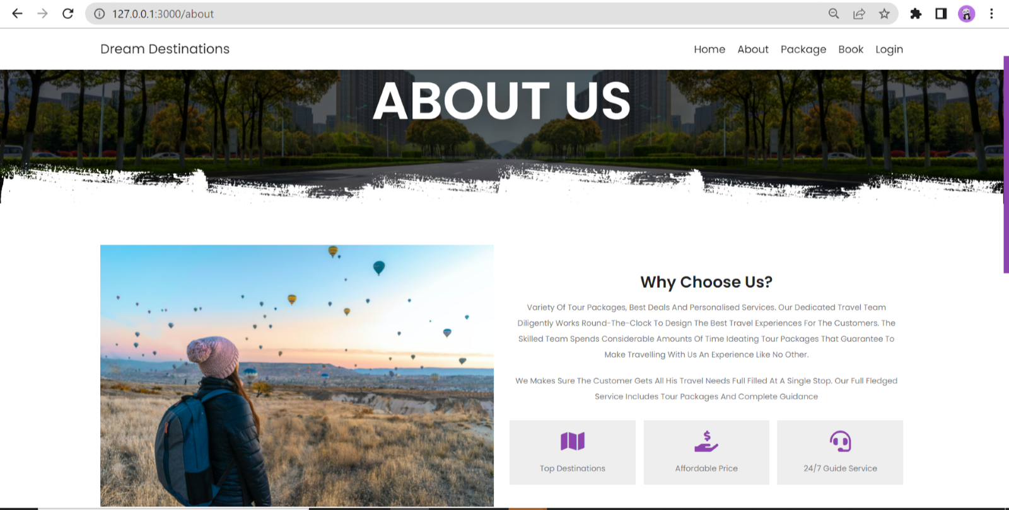
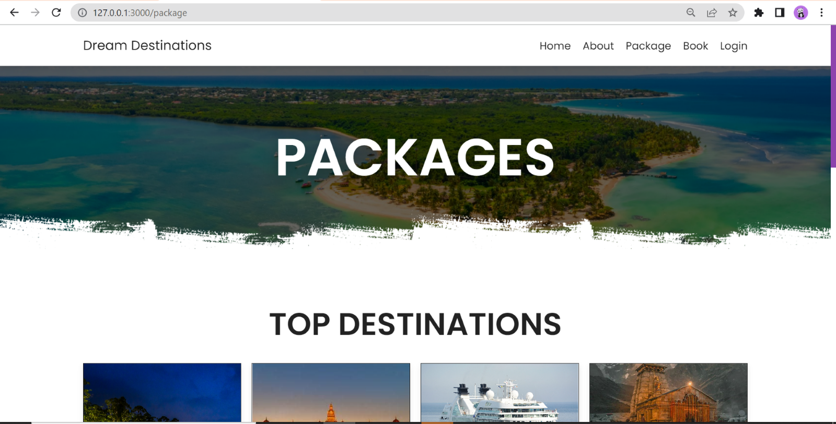
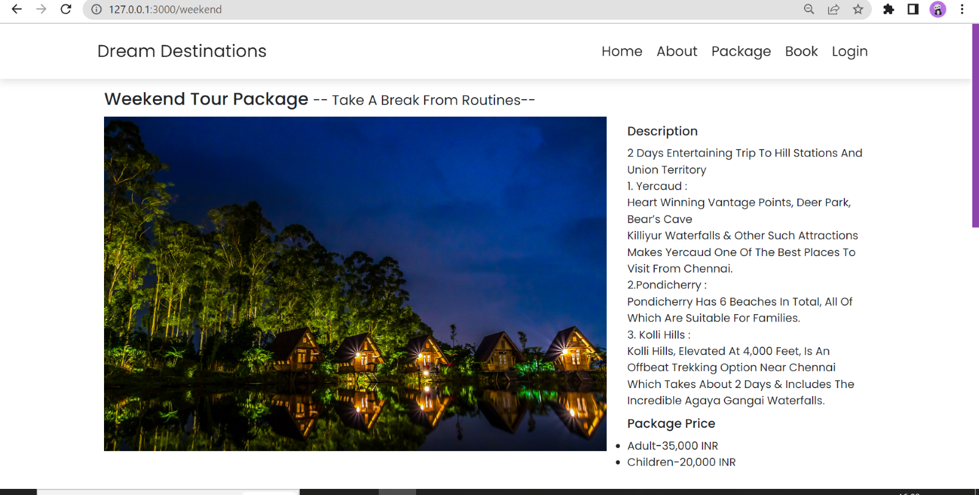
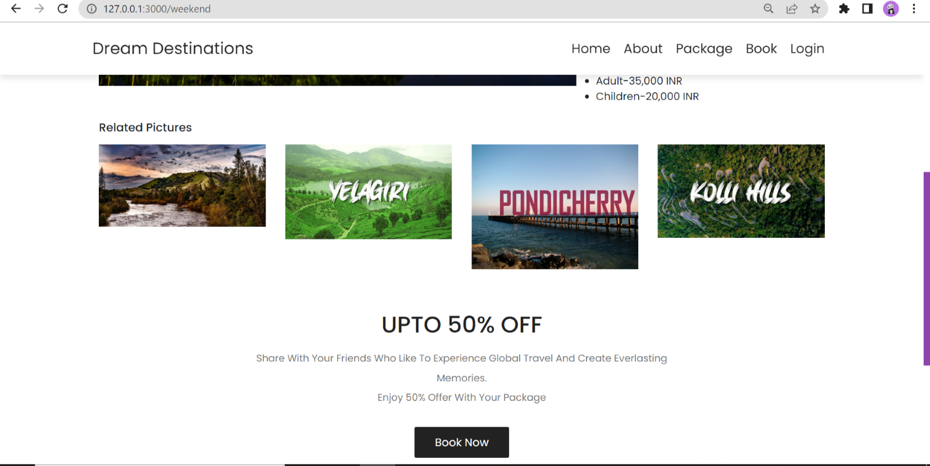

Slide 9
CONCLUSION
21
ADVANTAGES OF OUR PROJECT
PROS
Reliable and user friendly
2. Information Abstraction, Reuse are efficient methodologies
3. DB connected responsive and customizable webpage
DISADVANTAGE OF EXISTING PROJECT
CONS
1.Complex
2.Workprocess Tandem
3.No explicit information produced

Slide 10
GITHUB LINK & REFERENCES
[1] J. Honkola, H. Laine, R. Brown and O. Tyrkko, "Smart-M3 Information Sharing Platform", proc. IEEE Symp. Computers and Communications IEEE Comp. Soc, pp. 1041-1046, 2010.
[2] A. Smirnov, A. Kashevnik, N. Shilov, N. Teslya and A. Shabaev, "Mobile Application for Guiding Tourist Activities: Tourist Assistant - TAIS", proc. of the 16th Conference of Open Innovations Association FRUCT Oulu Finland IEEE, pp. 94-100, 2014.
[3] K. Kulakov and A. Shabaev, "An approach for creation smart space-based trip planning service", Proc. 16th Conf. of Open Innovations Association FRUCT, pp. 38-44, Oct. 2014.
Website Development (tutorialspoint.com)
Flask Tutorial (tutorialspoint.com)
Learn Flask | Codecademy
Flask Tutorials – Real Python
GITHUB REPO LINK - https://github.com/ShivaniSwaminathan/Final-Demo-Proj

Slide 11

22

